Slide 1
Python
AI VIETNAM
All-in-One Course
An Introduction
Quang-Vinh Dinh
Ph.D. in Computer Science
Year 2023

Slide 2
Outline
Programming Languages
Python Environment
Basic Data Types
Functions
Conditions

Slide 3


References
AI VIETNAM
All-in-One Course
Books
https://www.dropbox.com/sh/j8nvrjaw46tkgjx/AAA10WcRf2CMMmnW3gX4bVQta?dl=0
Python 101 - 2020
Beyond the Basic Stuff with Python

Slide 4


Programming Languages
AI VIETNAM
All-in-One Course
What should a programming language provide?
Objects
Numbers
Text
1, -2 …
a, b, c
-1.2, 2.7 …
Hello
Encode/Represent
…
Real World
2

Slide 5
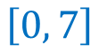



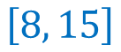
Programming Languages
AI VIETNAM
All-in-One Course
What should a programming language provide?
A way to represent numbers using bits
With three bits
Positive numbers
Negative numbers
Mixed
0
0
0
$$\left[0, 7\right]$$
$$\left[−1, −8\right]$$
$$\left[−3, 4\right]$$
0
0
1
$$\left[…\right]$$
$$\left[8, 15\right]$$
0
1
0
8 different
cases
0
1
1
1
0
0
1
0
1
1
1
0
1
1
1
3

Slide 6
Programming Languages
AI VIETNAM
All-in-One Course
What should a programming language provide?
A way to represent numbers using bits
With three bits
Positive numbers
Negative numbers
Mixed
0
0
0
$$\left[0, 7\right]$$
$$\left[−1, −8\right]$$
$$\left[−3, 4\right]$$
0
0
1
$$\left[…\right]$$
$$\left[8, 15\right]$$
0
1
0
8 different
cases
0
1
1
1
0
0
1
0
1
How to distinguish the cases?
1
1
0
1
1
1
4

Slide 7
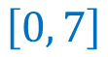


Programming Languages
AI VIETNAM
All-in-One Course
What should a programming language provide?
A way to represent numbers using bits
With three bits
+ Metadata
0
0
0
0
0
1
0
1
0
Type 1
Positive numbers
Type 2
Negative numbers
Type 3
Mixed
8 different
cases
0
1
1
1
0
0
1
0
1
$$\left[0, 7\right]$$
$$\left[−1, −8\right]$$
$$\left[−3, 4\right]$$
1
1
0
1
1
1
5

Slide 8


Programming Languages
AI VIETNAM
All-in-One Course
What should a programming language provide?
A way to represent numbers using bits
With eight bits
+ Metadata
256 different
cases
Type 1
unsigned char
Type 2
char
$$\left[0, 255\right]$$
$$\left[−127, 128\right]$$
Syntax for programmer
0
0
0
0
0
1
1
0
char a_number = 6;
6

Slide 9
Programming Languages
AI VIETNAM
All-in-One Course
What should a programming language provide?
How to represent floating-point numbers?
3.14
With 4 bytes
(32 bits)
float
With 8 bytes
(64 bits)
double
3 . 14
Syntax for programmer
float a_number = 3.14;
a set of bits
a set of bits
double another_number = 2.71;
7

Slide 10
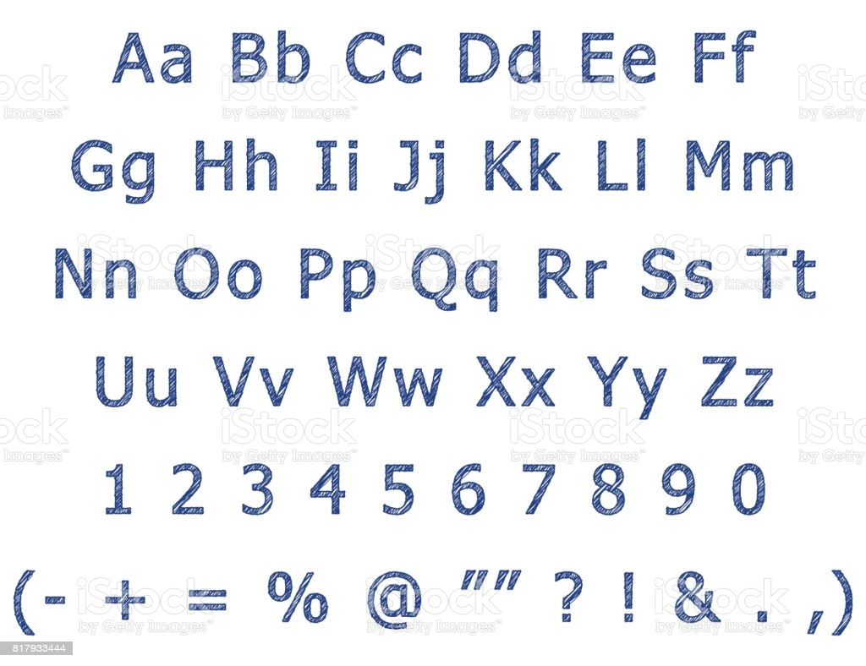
Programming Languages
AI VIETNAM
All-in-One Course
What should a programming language provide?
How to represent/store text using bits?
Need a mapping table!
8

Slide 11
Programming Languages
AI VIETNAM
All-in-One Course
What should a programming language provide?
How to represent/store text using bits?
Syntax for programmer
Decimal: 65
A mapping table
char a_number = ‘A’;
0
1
0
0
0
0
0
1
9

Slide 12
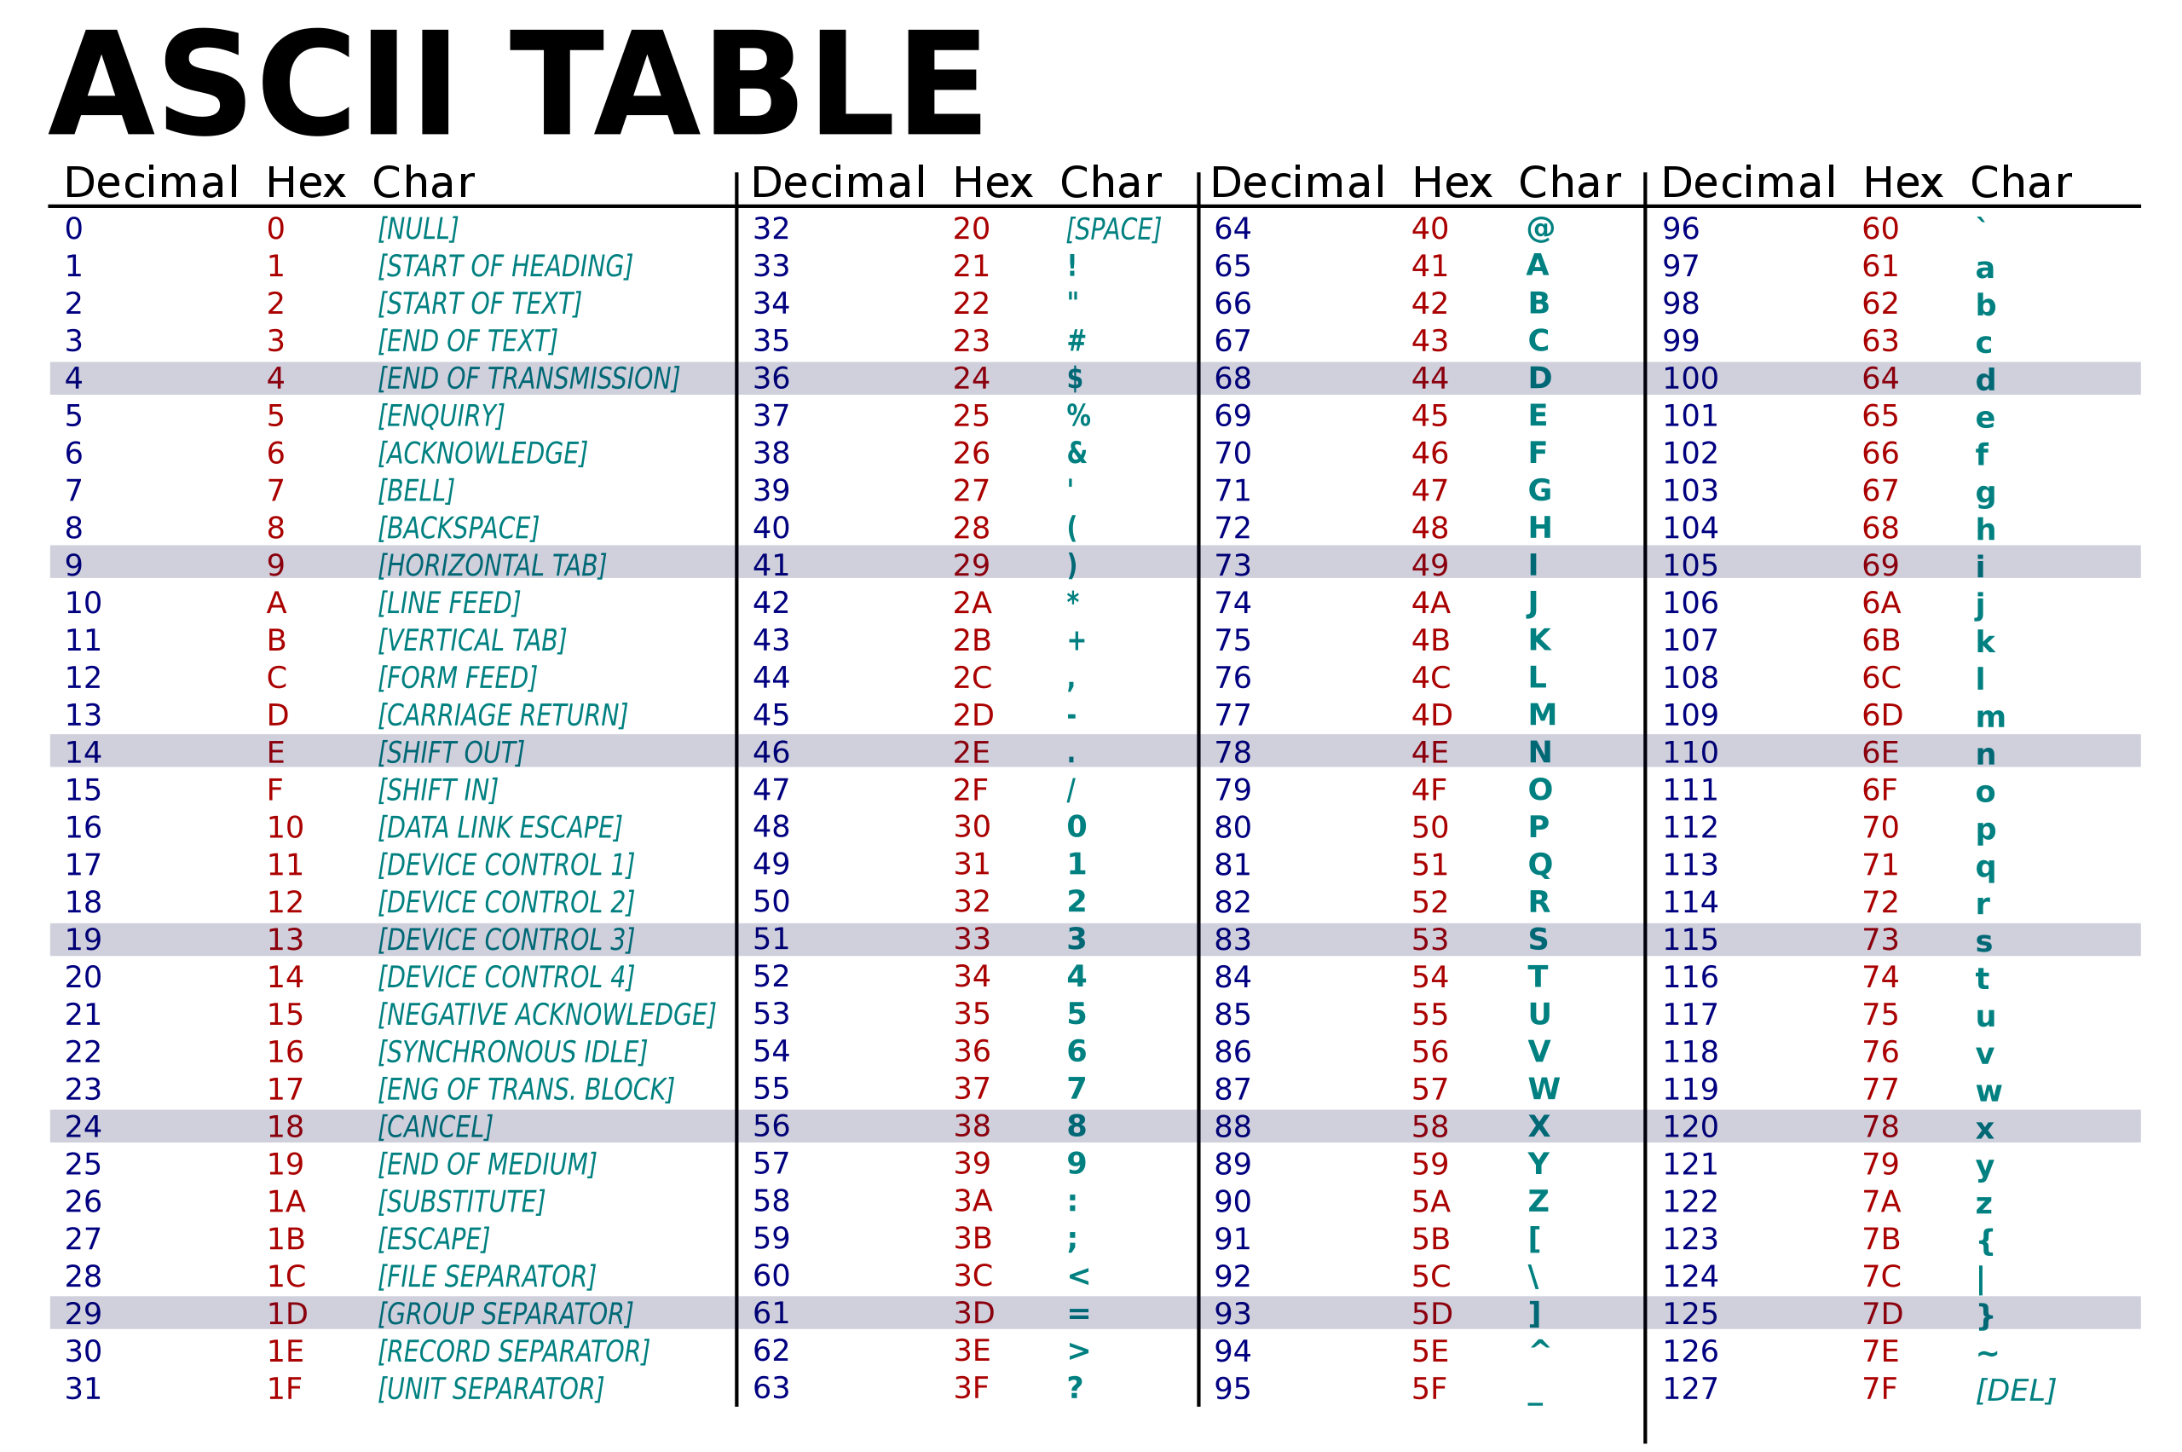
https://commons.wikimedia.org/wiki/File:ASCII-Table-wide.svg
10

Slide 13
Programming Languages
AI VIETNAM
All-in-One Course
What should a programming language provide?
Objects
Encode/Represent
Numbers
Text
…, 1, 2, 3 …
1, -2 …
a, b, c
-1.2, 2.7 …
Hello
double
1.4, 2.7, …
…
‘A’
float
‘1’
char
int
Real World
What’s more???
11

Slide 14
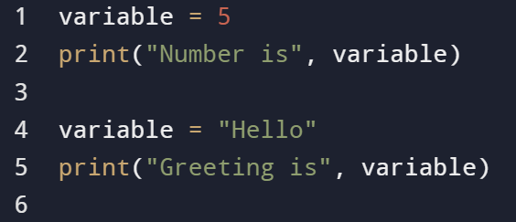
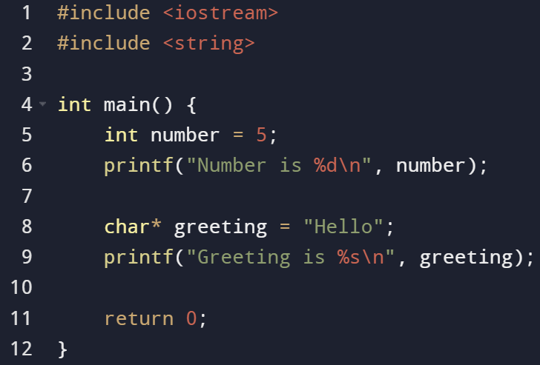
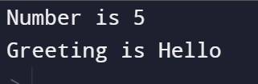
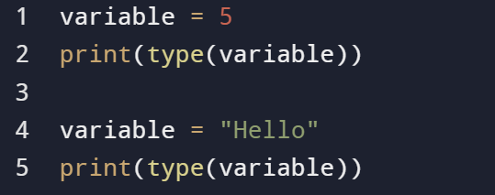
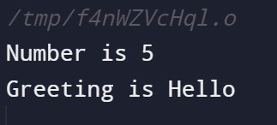
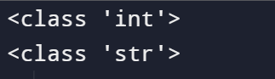
Programming Languages
AI VIETNAM
All-in-One Course
C++ and Python
C++ example
Python example
12

Slide 15
Outline
Programming Languages
Python Environment
Basic Data Types
Functions
Conditions

Slide 16
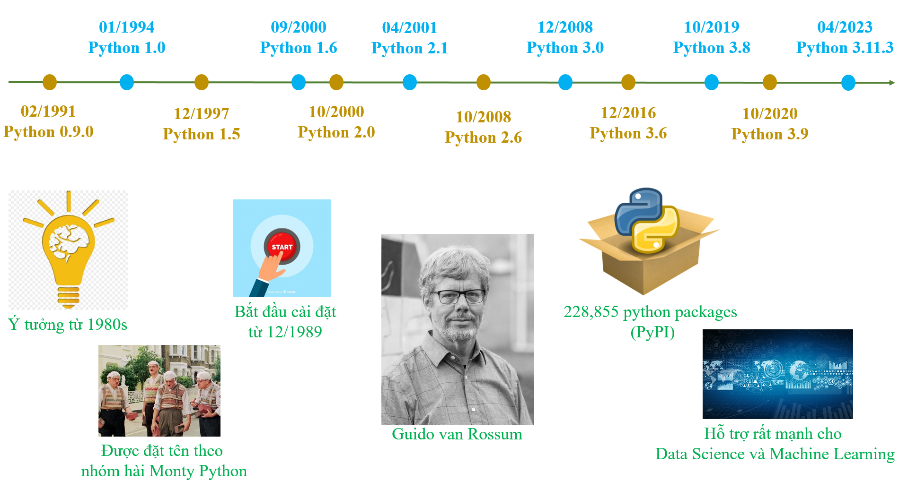
Introduction
AI VIETNAM
All-in-One Course
Python history
13
1

Slide 17
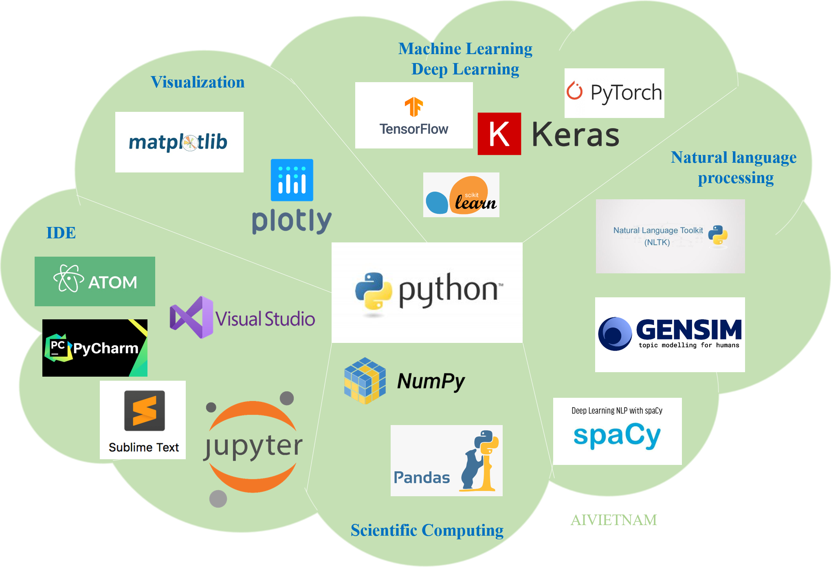
Introduction
AI VIETNAM
All-in-One Course
Python ecosystem
14
2

Slide 18
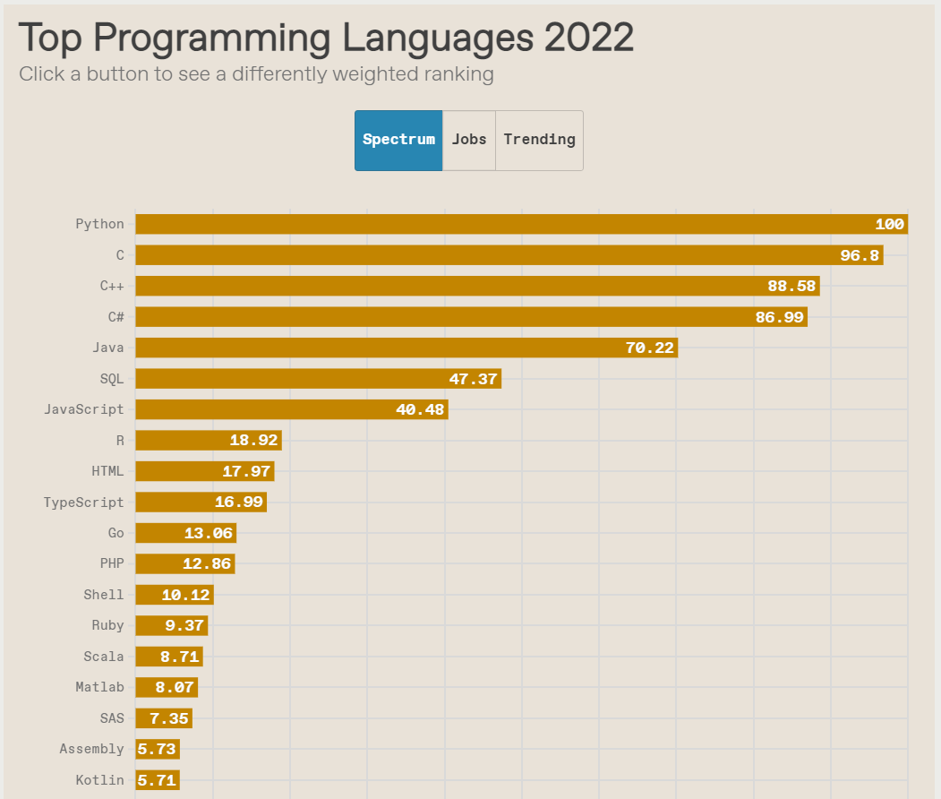
Introduction
AI VIETNAM
All-in-One Course
Top Programming Languages (08/2022)
https://spectrum.ieee.org/top-programming-languages-2022

Slide 19
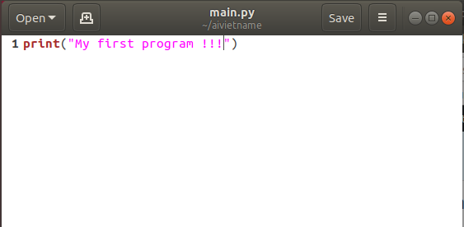
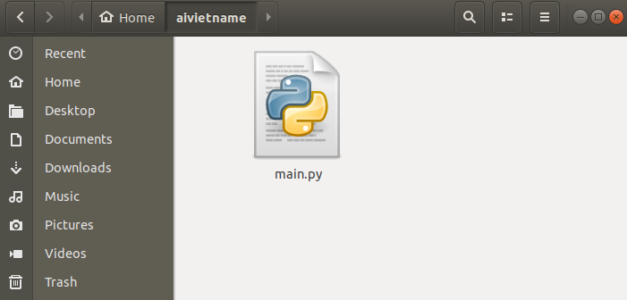
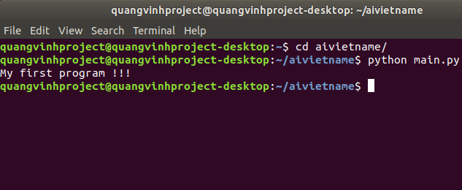
Introduction
AI VIETNAM
All-in-One Course
First Python program
Create a .py file
Write Python code
Run the file
Demo

Slide 20
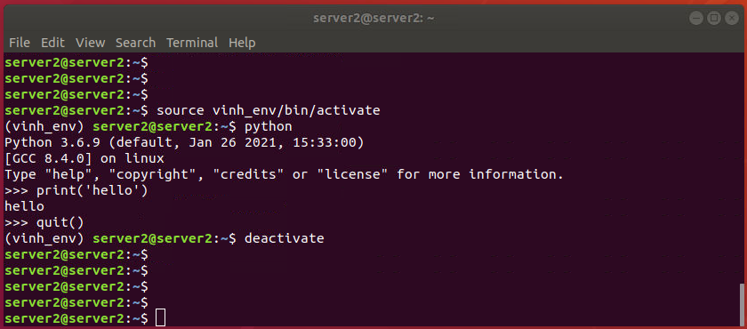
Introduction
AI VIETNAM
All-in-One Course
Virtual environment
sudo apt-get install -y python3-venv
python3 -m venv a_name
Python Environment
source a_name/bin/activate
Python 3.6
Tensorflow 1.4
Python 3.6
Tensorflow 2.1
Python 3.9
Pytorch
17

Slide 21
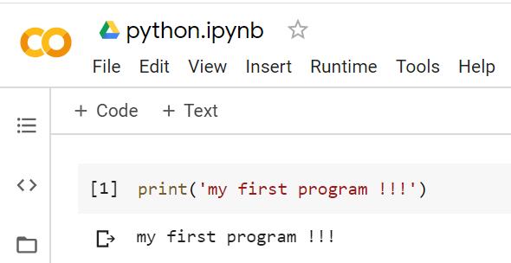
Introduction
AI VIETNAM
All-in-One Course
First Python program
Using Google Colab
https://colab.research.google.com/notebooks/intro.ipynb#recent=true
Demo
18
6

Slide 22
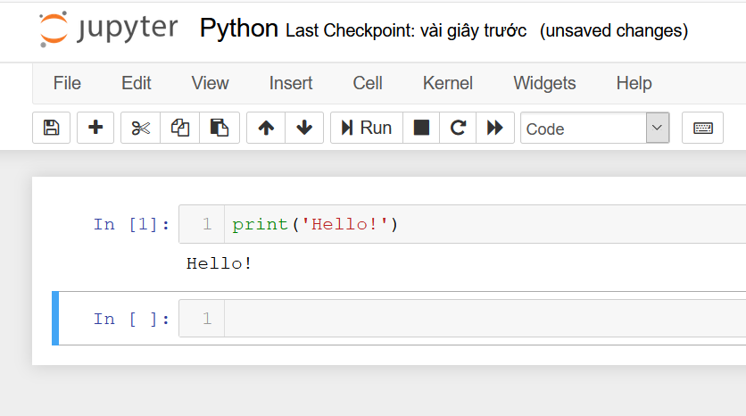
Introduction
AI VIETNAM
All-in-One Course
First Python program
Using Anaconda + Jupyter Notebook
Setting up environment
conda create -n test_env2 python=3.9
conda activate an_env
conda deactivate
Some common commands
To check packages installed
pip list
Open the jupyter program
jupyter notebook
Demo
To install a package
pip install package_name

Slide 23
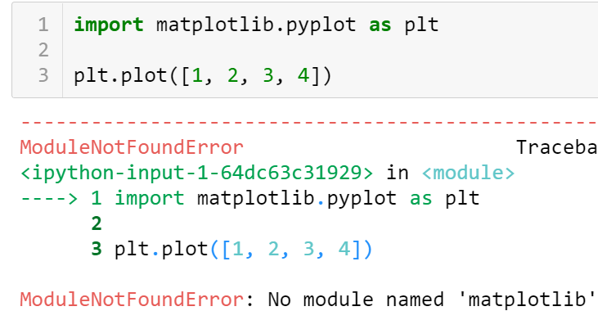
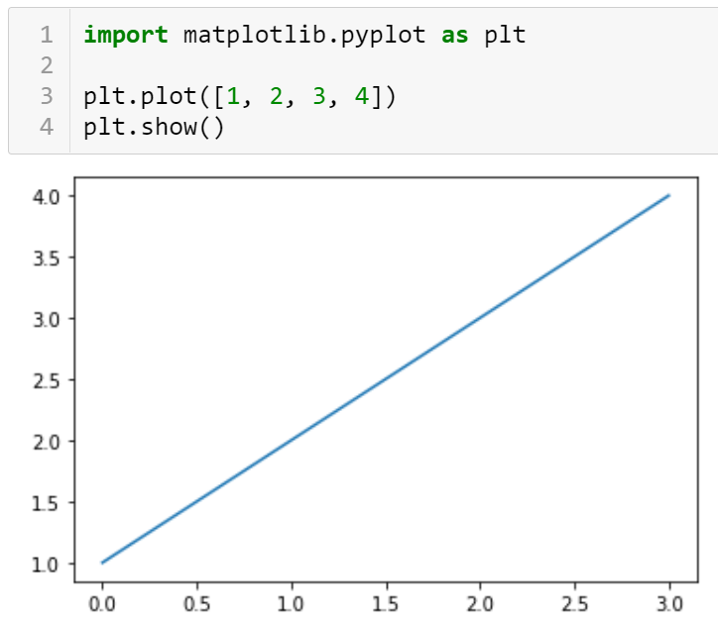
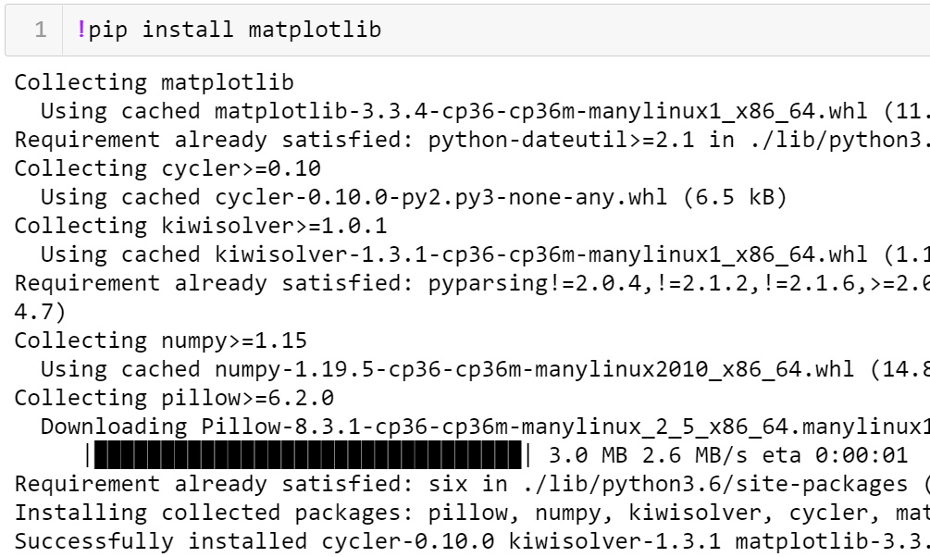
Introduction
Install new package
pip install matplotlib

Slide 24
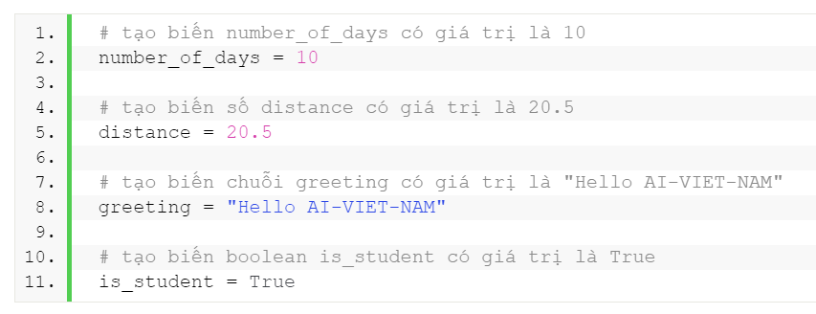
Variable
AI VIETNAM
All-in-One Course
variable_name = variable_value
Variable values
Integer
1, 2, 3, 0, -1, -2
Float
1.5, 0.5, -3.21, 1.0
String
'Joe', 'Schmoe', "Joe", "Schmoe"
Boolean
True, False
21
4

Slide 25
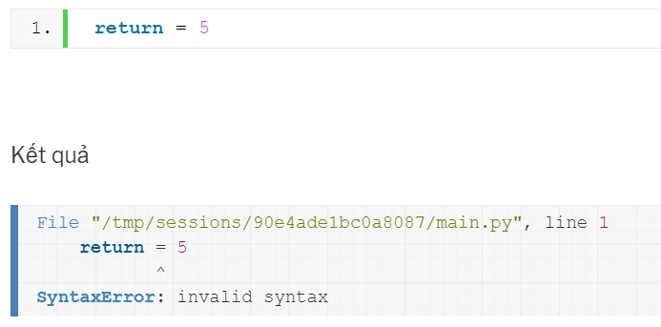
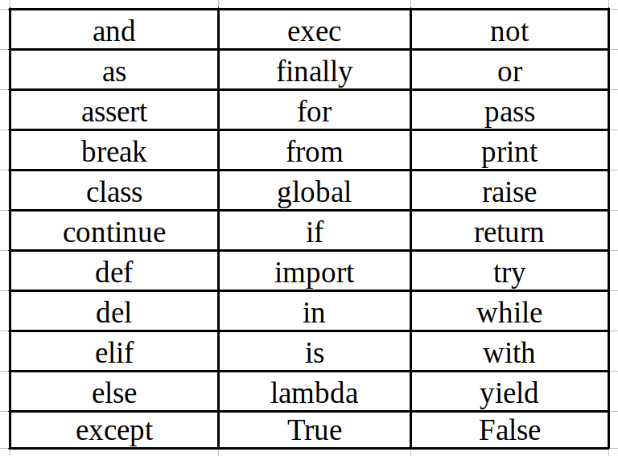
Variable
AI VIETNAM
All-in-One Course
Demo
variable_name = variable_value
variable_name
Example
Should has a meaning
Cannot use keywords
22
4

Slide 26
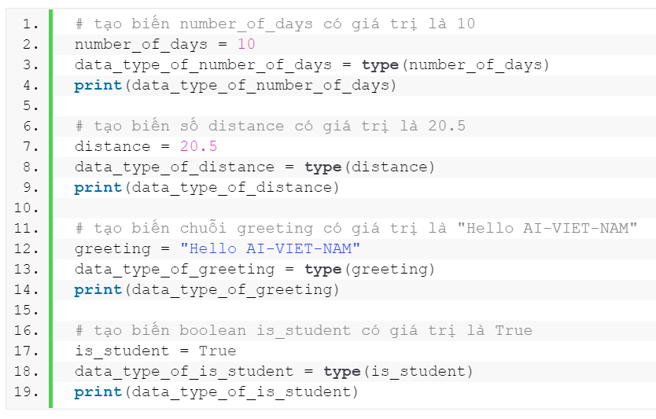
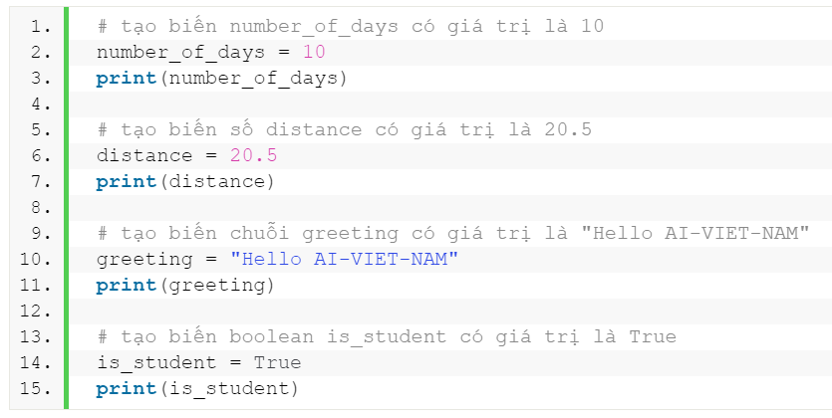
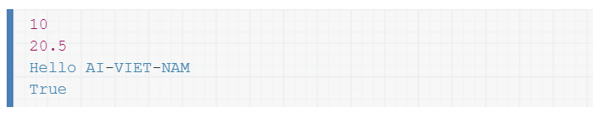
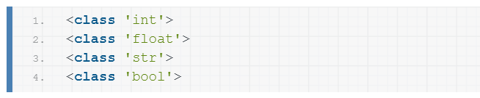
Built-in Functions
AI VIETNAM
All-in-One Course
type(parameter)
print(parameters)

Slide 27
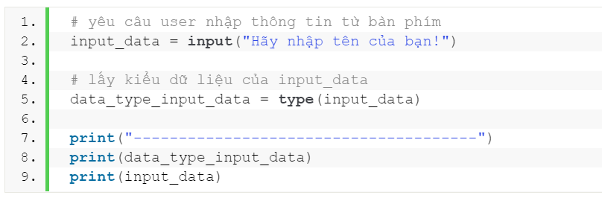
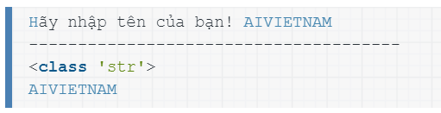
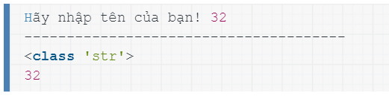
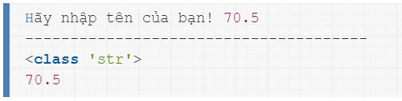
Built-in Functions
AI VIETNAM
All-in-One Course
input(promt)
24
4

Slide 28
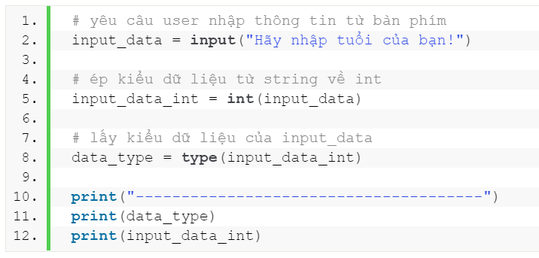
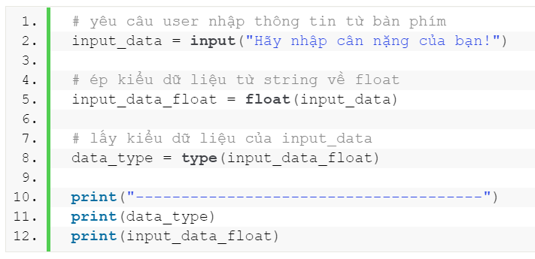
Built-in Functions
AI VIETNAM
All-in-One Course
Type Conversion
int()
float()
Demo
25
4

Slide 29
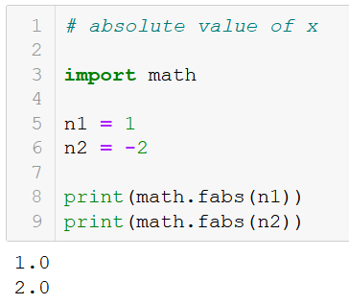
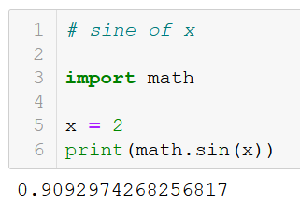
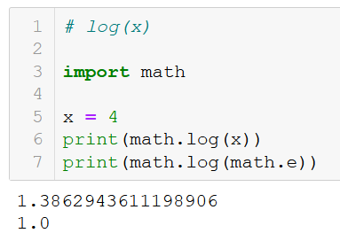
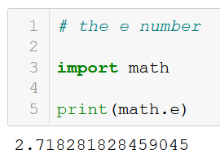
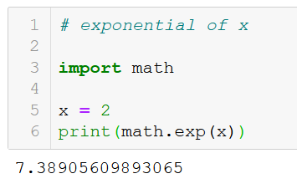
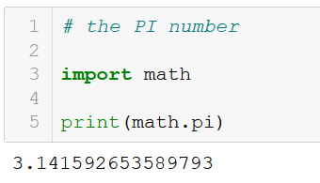
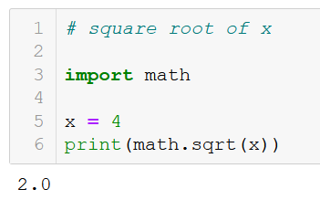
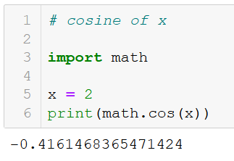
Random and Math Modules
AI VIETNAM
All-in-One Course
Demo
https://docs.python.org/3/library/math.html
26
4

Slide 30
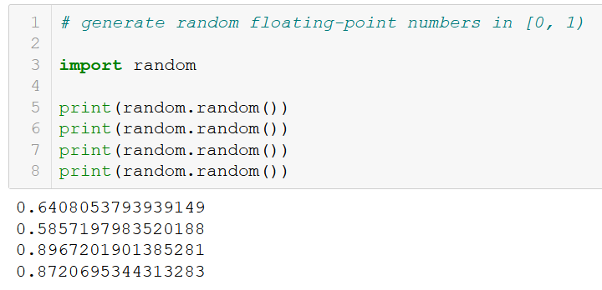
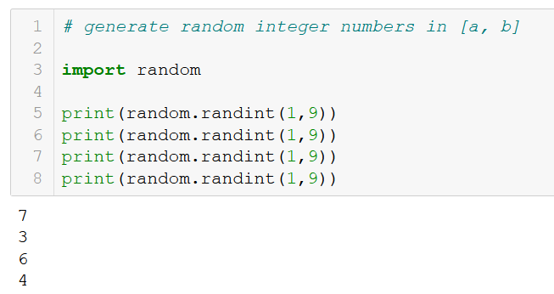
Random and Math Modules
AI VIETNAM
All-in-One Course
Demo
https://docs.python.org/3/library/random.html
27
4

Slide 31
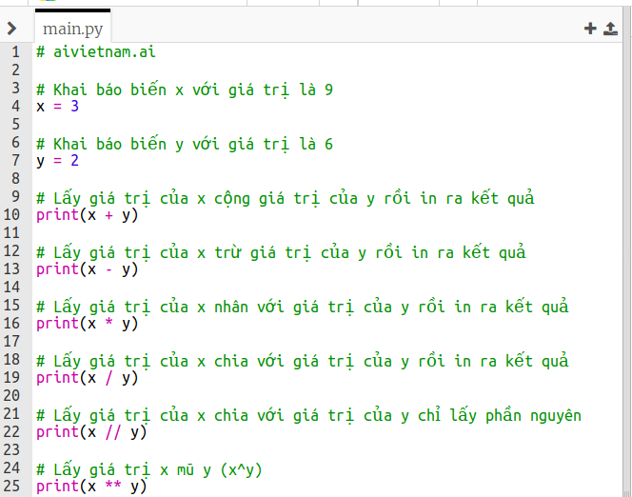
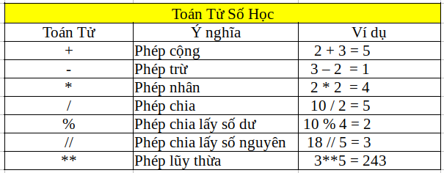
Basic Operators
AI VIETNAM
All-in-One Course
Demo
28
4

Slide 32
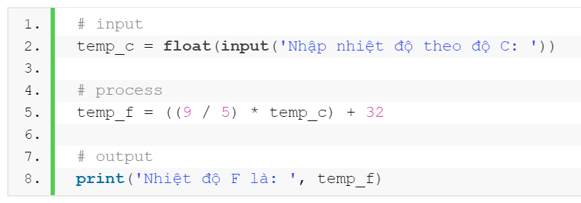
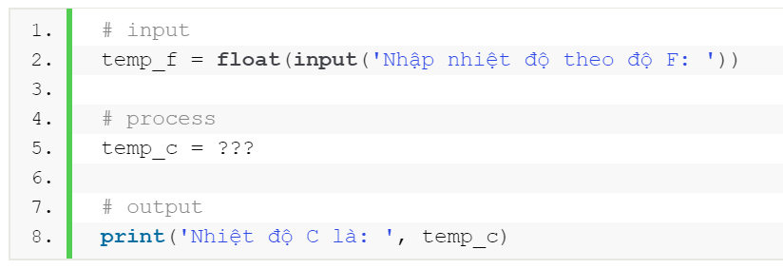


Example
AI VIETNAM
All-in-One Course
Celsius to Fahrenheit conversion
Celsius to Fahrenheit conversion
$$F=\frac{9C}{5}+32$$
$$C=\left(F−32\right)\frac{5}{9}$$
29
4

Slide 33

Example
AI VIETNAM
All-in-One Course
Circumference and area of common shapes
Demo
30
4

Slide 34
Questions
AI VIETNAM
All-in-One Course
?

Slide 35

Functions
AI VIETNAM
All-in-One Course
Notes for function construction
parentheses
colon
Define function name
Lowercase with underscores and begin with a verb
Indentation Use 4 spaces for indentation
keyword
Determine function parameters
Input data help the function done
Do docstring Explain and describe the function
General structure of a function
Output of the function
indentation
Demo (rectangle)
31
4

Slide 36

Functions
AI VIETNAM
All-in-One Course
Name
compute_rectangle_area
Parameter
height, width
Define function name
Lowercase with underscores, usually begin with a verb
Output
area
Determine function parameters
Input data help the function done
Do docstring Explain and describe the function
Output of the function
32
4

Slide 37


Functions
AI VIETNAM
All-in-One Course
Default values
Default values
33
4

Slide 38








Limit
Compute the circumference of a unit circle
$$r=1$$
$$L$$
$$h$$
$$r=1$$
$$α$$
$$b$$
$$sin\left(α\right)=\frac{h}{r}$$
Divide the length into m segments
$$L=m∗sin\left(α\right)$$
$$sin\left(α\right)=h$$
2

Slide 39











Compute the circumference of a unit circle
$$y=3.14159$$
$$length$$
$$r=1$$
$$f(x)$$
$$h$$
$$α$$
$$degree$$
Divide the length into m segments
$$b$$
$$L=m∗sin\left(α\right)$$
3

Slide 40











Limit
Compute the area of a unit circle
$$A_{α }=\frac{hb}{2}$$
$$r=1$$
$$h$$
$$r=1$$
$$α$$
$$A_{α }$$
$$b$$
$$sin\left(α\right)=\frac{h}{r}$$
$$⇒A_{α }=\frac{sin\left(α\right)cos\left(α\right)}{2}$$
$$cos\left(α\right)=\frac{b}{r}$$
$$⇒A=m∗A_{α }$$
where m is a number of parts
4

Slide 41







Limit
Compute the area of a unit circle
$$r=1$$
$$A_{α }$$
$$r=1$$
$$⇒A_{α }=\frac{sin\left(α\right)cos\left(α\right)}{2}$$
$$h$$
$$α$$
$$⇒A=m∗A_{α }$$
$$b$$
5

Slide 42













Limit
Compute the area of a unit circle
$$f(x_{1})$$
$$f(x_{2})$$
$$f(x_{n})$$
$$f(x)$$
$$A_{est}≈$$
$$+$$
$$+$$
$$…$$
$$+$$
$$∆x_{1}$$
$$∆x_{2}$$
$$∆x_{n}$$
$$A_{est}≈\sum_{i=1}^{n}{f(x_{i})∆x_{i}}$$
$$\lim_{∆x→0}{A_{est}}=A_{real}$$
6

Slide 43



Limit
Compute the area of a unit circle
$$f(x)$$
$$A_{est}≈\sum_{i=1}^{n}{f(x_{i})∆x_{i}}$$

Slide 44

Sigmoid Function
AI VIETNAM
All-in-One Course
Sigmoid function
$$y=σ(u)=\frac{1}{1+e^{−u}}$$
$$y_{2}$$
$$u∈\left(−∞ +∞ \right)$$
$$y∈\left(0 1 \right)$$
$$y$$
Property
$$y_{1}$$
$$∀u_{1}u_{2}∈\left[a b\right] \text{v}\text{à }u_{1}≤u_{2}$$
$$u_{1}$$
$$u_{2}$$
$$→σ(u_{1}\text{)}≤σ\text{(}u_{1}\text{)}$$
$$u$$
$$−∞$$
$$+∞$$
34

Slide 45





Activation Functions
$$\tanh\left(x\right)=\frac{e^{x}−e^{−x}}{e^{x}+e^{−x}}$$
S-shaped curves
Map x values into small ranges
$$\operatorname{sigmoid}\left(x\right)=\frac{1}{1+e^{−x}}$$
35

Slide 46


Overflow and Underflow
AI VIETNAM
All-in-One Course
Why?
36

Slide 47
Overflow and Underflow
AI VIETNAM
AI Insight Course
Softmax function
Input
Probability
$$z_{1}=1.0$$
Softmax
$${f(z}_{1})=0.12$$
$$P_{i}=f\left(z_{i}\right)=\frac{e^{z_{i}}}{\sum_{j}{e^{z_{j}}}}$$
$$z_{2}=3.0$$
$${f(z}_{2})=0.88$$
$$0≤f\left(z_{i}\right)≤1$$
$$\sum_{i}{f\left(z_{i}\right)}=1$$
Input
Probability
$$z_{1}=1.0$$
$${f(z}_{1})=0.09$$
Softmax
$$z_{2}=2.0$$
$${f(z}_{2})=0.24$$
$$z_{3}=3.0$$
$${f(z}_{3})=0.67$$
37

Slide 48











Softmax function
Implementation (straightforward)
Chuyển các giá trị của một vector thành các giá trị xác suất
Formula
Input
Probability
$$f\left(x_{i}\right)=\frac{e^{x_{i}}}{\sum_{j}{e^{x_{j}}}}$$
$$x_{1}=1.0$$
Softmax
$${f(x}_{1})=0.09$$
$$0≤f\left(x_{i}\right)≤1$$
$$x_{2}=2.0$$
$${f(x}_{2})=0.24$$
$$\sum_{i}{f\left(x_{i}\right)}=1$$
$$x_{3}=3.0$$
$${f(x}_{3})=0.67$$

Slide 49











Softmax function
Implementation (straightforward)
Chuyển các giá trị của một vector thành các giá trị xác suất
Formula
Input
Probability
$$f\left(x_{i}\right)=\frac{e^{x_{i}}}{\sum_{j}{e^{x_{j}}}}$$
$$x_{1}=1.0$$
$${f(x}_{1})=0.09$$
Giá trị nan vì $e^{x}$ vượt giới hạn lưu trữ của biến
Softmax
$$0≤f\left(x_{i}\right)≤1$$
$$x_{2}=2.0$$
$${f(x}_{2})=0.24$$
$$\sum_{i}{f\left(x_{i}\right)}=1$$
$$x_{3}=3.0$$
$${f(x}_{3})=0.67$$
$$e^{x}$$
Hàm mũ tăng rất nhanh khi x tăng
$$x∈[0, +∞)$$
$$e^{x}∈[1, +∞)$$
$$x$$
39

Slide 50








Softmax function (stable)
Implementation (stable)
$$e^{x}$$
(Stable) Formula
X
X-m
Probability
$$x∈(−∞, 0)$$
$$m=max⁡(x)$$
$$x_{1}=1.0$$
$$x_{1}=−2.0$$
$${f(x}_{1})=0.09$$
$$e^{x}∈(0, 1)$$
Softmax
$$f\left(x_{i}\right)=\frac{e^{{(x}_{i}−m)}}{\sum_{j}{e^{(x_{j}−m)}}}$$
$$x_{2}=2.0$$
$$x_{2}=−1.0$$
$${f(x}_{2})=0.24$$
$$x_{3}=3.0$$
$$x_{3}=0$$
$${f(x}_{3})=0.67$$
$$x$$

Slide 51
Exponential Functions
AI VIETNAM
AI Course 2022
Example
Suppose a person invests P dollars in a savings account with an annual interest rate r, compounded annually. The amount of money after 1 year is
If the money is compounded 2 times per year, the amount of money after half a year is
$$A_{1/2}=A+\frac{r}{2}A=A\left(1+\frac{r}{2}\right)$$
$$A_{1}=A+rA=A\left(1+r\right)$$
The amount of money after 2 years is
The amount of money after 1 year is
$$A_{2}=A_{1}+rA_{1}=A\left(1+r\right)+rA\left(1+r\right)=A{\left(1+r\right)}^{2}$$
$$A_{1}=A\left(1+\frac{r}{2}\right)+\frac{r}{2}A\left(1+\frac{r}{2}\right)=A{\left(1+\frac{r}{2}\right)}^{2}$$
More generally, the amount after t years is
After t years, the amount of money in the account is
$$A_{t}=A{\left(1+r\right)}^{t}$$
$$A_{t}=A{\left(1+\frac{r}{2}\right)}^{2t}$$
Year 2022
42

Slide 52

Exponential Functions
AI VIETNAM
AI Course 2022
Example
$$y=e$$
This example is from the reference book
After t years, the amount of money in the account is
$$y={\left(1+\frac{1}{m}\right)}^{m}$$
$$A_{t}=A{\left(1+\frac{r}{2}\right)}^{2t}$$
More generally, if the money is compounded n times per year, the amount of money in the account after t years is given by the function
$$A_{t}=A{\left(1+\frac{r}{n}\right)}^{nt}$$
$$\lim_{m→∞}{{\left(1+\frac{1}{m}\right)}^{m}}=e$$
set $m=\frac{n}{r}$
$$A_{t}=A{\left(1+\frac{1}{m}\right)}^{mrt}$$
$$A_{t}=Ae^{rt}$$

Slide 53


Example
Euler's number
$$e≈{\left(1+\frac{1}{n}\right)}^{n}$$
https://www.mathsisfun.com/numbers/e-eulers-number.html
44
4

Slide 54
Outline
Programming Languages
Python Environment
Basic Data Types
Functions
Conditions

Slide 55


Condition
AI VIETNAM
All-in-One Course
Comparison operators
41
4

Slide 56

Condition
AI VIETNAM
All-in-One Course
if condition
colon
Khối code K1
keyword
Điều kiện if
False
True
Khối code trong if
indentation
Khối code K2
42
4

Slide 57





Condition
AI VIETNAM
All-in-One Course
if condition
$$\operatorname{ReLU}\left(x\right)=\left\{\begin{aligned}0 if x≤0 \\ x if x>0\end{aligned}\right.$$
43
4

Slide 58

Condition
AI VIETNAM
All-in-One Course
if-else condition
colon
Khối code (K1)
Điều kiện if
False
keyword
True
Khối code trong if
Khối code trong else
indentation
Khối Code (K2)
44
4

Slide 59
Condition
AI VIETNAM
All-in-One Course
if-else condition
if condition
$$\operatorname{ReLU}\left(x\right)=\left\{\begin{aligned}0 if x≤0 \\ x if x>0\end{aligned}\right.$$
Demo
45
4

Slide 60

Condition
AI VIETNAM
All-in-One Course
if-elif-else condition
colon
Khối code (K1)
Điều kiện if
False
Điều kiện elif
False
True
True
Khối code trong if
Khối code trong elif
Khối code trong else
indentation
Khối Code (K2)

Slide 61



Condition
AI VIETNAM
All-in-One Course
$$\operatorname{LTP}\left(x,y\right)=\left\{\begin{aligned} 0 if x=y \\ 1 if x>y \\ −1 if x<y\end{aligned}\right.$$
if-elif-else condition
$$\operatorname{FuzzyEncoding}\left(x,y,T\right)=\left\{\begin{aligned}5, \\ 4, \\ 3, \\ 2, \\ 1,\end{aligned}\right.$$
$$\begin{aligned} if x+T≤y \\ if x<y<x+T \\ if x=y \\ if y<x<y+T \\ if y+T≤x\end{aligned}$$
5
4
3
2
1
T
47
4

Slide 62







AI VIETNAM
All-in-One Course
If-Else Condition and Math (1)
Input: $a$ and $b$
Input: $a$ and $b$
$$if a=0 then y=b^{2}$$
$$y={\frac{a}{K}\left(\sqrt{b}\right)+\frac{\left(K−a\right)}{K}b}^{2}$$
$$if a=K then y=\sqrt{b}$$
48

Slide 63









AI VIETNAM
All-in-One Course
If-Else Condition and Math (2)
Input: $a$ and $b$
Input: $a$ and $b$
$$if a>0 then$$
$$y=\frac{\left(b^{2}+\sqrt{b}\right)}{2}+\frac{\left(b^{2}−\sqrt{b}\right)}{2}\frac{\left|a\right|}{a}$$
$$y=b^{2}$$
$$if a<0 then$$
$$y=\sqrt{b}$$
49

Slide 64













AI VIETNAM
All-in-One Course
If-Else Condition and Math (3)
Input: $a$ and $b$
Input: $a$ and $b$
$$if a=0 then y=b^{2}$$
Convert $a$ into a one-hot vector $v$
$$u=[b^{2} \sqrt{b} b]$$
$$v=[1 0 0]$$
$$if a=1 then y=\sqrt{b}$$
$$v=[0 1 0]$$
$$if a=2 then y=b$$
$$y=v∙u$$
$$v=[0 0 1]$$
50

Slide 65
Cheat Sheet – Lesson 1
AI VIETNAM
Run a Python program
Basic Operators
Condition
Overflow/Underflow
_ Python files have “.py” at the end of the filename
Operators | Meaning
+ | Summation
- | Subtraction
* | Multiplication
/ | Division
% | Modulo
// | Floor Division
** | Power
_ Comparision Operators:
_ Underflow:
_ To run a Python file:
== | Equal
!= | Not equal
> | Greater than
< | Less than
>= | Greater or equal than
<= | Less or equal than
result = 1e-100
print(result) # 1e-100
result = 1e-1000
print(result) # 0.0
python file.py
Virtual Environment
_ Overflow:
_ Install Python Virtual Environment (in Linux):
result = 1e100
print(result) # 1e+100
result = 1e1000
print(result) # inf
sudo apt-get install –y python3-env
_ Create a virtual environment:
python3 –m venv a_name
_ Activate a virtual environment:
_ Conditional sentence:
For Loop
source a_name/bin/activate
if condition1:
# your code
elif condition2:
# your code
else:
# your code
_ Create a loop using for:
Install new package
for element in iterable:
# code inside your for
_ e.g: to install matplotlib:
Function
_ Some iterables:
pip install matplotlib
String | “aivietnam”
Tuple | (1, 2, 3)
List | [1, 2, 3]
Dictionary | {‘key1’: 1}
range() | range(0, 5, 1)
_ Define a function:
Variable
Built-in Functions
def function_name(paramerters):
‘‘‘
docstring
‘‘‘
# your code goes here
return result
_ Declare a variable:
print(params) | Print value onto the screen
type(params) | Return class type of variable
input(prompt) | Ask user to input a string
int(), float() | Type conversion
variable_name = variable_value
_ Variable types:
Integer | 1, 2, 0, -1, -2
Float | 1.5, 0.5, -3.21
String | ‘AI’, “VIETNAM”
Boolean | True, False
_ Special keywords:
_ Default values:
break | Exit the loop
continue | Move to next iteration
def function_name(p1=0, p2=0):
# your code goes here

Slide 66


